Slide 1
Christian and social scientific understandings of human beings in society
Session 1: Social Sciences and Law stream
March 18, 2016
Donald Hay

Slide 2
Within the mainstream of your discipline, what is the dominant understanding of what it is to be a human being? Do you find that understanding satisfactory?
Notes:
Why is understanding important? Modelling and explaining social and economic behaviour
Implicitly normative – defines what is good and bad for human flourishing, and hence evaluation of social and economic arrangements

Slide 3
Outline
Five understandings of human beings in society:
Theological
Evolutionary psychology
Rational choice theories
Social theories
Persons (the social theory of Christian Smith)

Slide 4
1 Theological understanding
1.1 Creation:
from dust of the ground (Genesis 2: 7)
in the image of the Triune God (Gen 1: 27): relational, man and woman (Gen 2:20-24)
rule and responsibility for the created order, exercised through work and rest (Gen1:26, 28)
capacity for understanding: naming the animals (Gen 2: 19, 20)
capacity for making moral choices (Gen 3)

Slide 5
1.2 What is the purpose of human life?
Persons in relationships, with purposes
to love God and serve him with all our being (Luke 10: 27)
to love our neighbours as ourselves (Luke 10: 27)
to benefit from, and to care for, the created order (Genesis 1: 26, 28-30)

Slide 6
1.3 Fall and disobedience: Genesis 3
The dark side of Christian anthropology.
Fall presupposes capacity to make autonomous decisions
Consequences: all three relationships fractured
and broken
separation from God: Adam and Eve try to hide: Babel
power and deception in human relationships: Adam and Eve, Cain and Abel
interaction with created order becomes ‘toil and sweat’ (Genesis 3: 17-19)

Slide 7
1.4 Implications of the Fall for human nature?
Paul’s concept of the ‘sinful nature’ (Romans 8: 5-8): predisposition to sin, enslaves us
Consequences for human behaviour (Romans 1, Galatians 5: 19-21): ‘acts’ of the sinful nature
Salvation: renewed relationship with God in Christ, enabled to ‘crucify’ the sinful nature, and to live by the Spirit: fruit of the Spirit (Galatians 5: 16-18, 22-25)
Image of God is grievously marred and distorted, but not completely destroyed.
(Augustinian theology: some contrasts with….)
Notes:
Romans 8: 5 ‘Those who live according to the sinful nature have their mind set on what that nature desires…’
Verse 8 ‘Those controlled by the sinful nature cannot please God..’

Slide 8
1.5 Aquinas 1225-1274
Creation and teleology: purpose of creation derived from will of the Creator
Distinctiveness of human beings is the intellect: human rationality understanding teleology – free will and responsibility for actions
Evil traced to sin, but not ‘total depravity’ – humanity still essentially good, and reason can reach out to God
Natural law – pursuit of natural inclinations is conducive: to our good – self preservation, procreation and care for offspring; and ‘to the good’ - dispelling ignorance, cooperating with others.

Slide 9
1.6 17C and 18C philosophical ideas, and the birth of social science
See R Trigg, Ideas of Human Nature
Hobbes (1588-1679): ‘engines’, individualistic, deterministic, selfish (‘psychological egoism’); competitive (‘state of nature’), fear engenders cooperation
Locke (1632-1704): reasoning beings in God’s image; created order – natural law; empiricist; behaviour governed by pain/ pleasure principle
Hume (1711-1776): experience of our senses rather than reason; fixed human nature, deterministic; ruled by our passions, reason enables us to achieve what our passions demand
Notes:
Enlightenment: theological understanding undermined, development of social sciences
Hobbes – nature
Locke – devout Christian – natural law to be discovered by revelation and reason. Reason rules.
Hume: No natural law (not ‘ought’ from ‘is’). Reason as the servant of the passions.

Slide 10
2. Evolutionary psychology
2.1 Human nature (‘evolved psychological mechanisms’) the product of our evolutionary past (Pleistocene era):
Evolutionary mechanisms:
Adaptation: selection for characteristics that solve problems of survival or reproduction
Inclusive fitness (W D Hamilton): the ‘genes eye view’ – not just the individual carrier of a gene, but all close relatives
Implication: natural selection favours mechanisms for ‘altruism’ when costs are less than benefits weighted by degree to which genes are shared
Notes:
Echoes of Hobbes
Selection a sieve
c<rb

Slide 11
Understanding human behaviour
Hence ‘evolved psychological mechanisms’ - ‘hard wired’ into our bodies/ brains: source of our behaviour
Cues to act in particular ways in response to threats to survival or to opportunities to reproduce.
‘The primary non-arbitrary way to identify, describe, and understand psychological mechanisms is to articulate their functions – the specific adaptive problems they were designed by selection to solve’. [D Buss, 1999]

Slide 12
2.2 An example: kinship and family
Problems of kinship - theoretical themes and empirical hypotheses:
Siblings – competition for resources from parents vs. altruism towards siblings
Male relatives – greater opportunities for spreading genes via multiple matings
Degree of cooperation and solidarity among kin a function of degree of relatedness
Humans need to know in detail who are their kin
Notes:
Inclusive fitness: sharing genetic inheritance: 50% parents, children, siblings; 25% grandparents, grandchildren, uncles, aunts, nieces, nephews, 12.5% first cousins

Slide 13
Kinship and family: some evidence
(Major) acts of helping kin – greater with close genetic relative, decreasing with age of relative
Inheritance – bequests greater to offspring than siblings despite equal relatedness
Inheritance – men typically leave high proportion of bequests to wife (generally benefitting offspring), but not vice versa – husband more likely to marry again and have children
Grandmothers give more resources to grandchildren than do grandfathers – greater certainty about degree of relatedness
Women are better than men in identifying kin

Slide 14
Why human families?
Family a particular characteristic of humans.
Costs to offspring not conducive to family formation: (a) reproduction delayed; (b) competition for resources.
Ecological constraints model (Emlen):
Scarcity of reproductive opportunities outside the family
Enhanced survival, opportunity for skill formation
Sharing/ inheriting ‘family territory’
Reproductive vacancy arising on death of parent
Notes:
Only three percent of animal and avian species form families
Scarcity of reproductive resources lowers benefit from leaving.

Slide 15
2.3 What are we to make of evolutionary psychology?
Reductionist – an explanation of all human behaviour – E O Wilson, Consilience
No reason to exclude biological drives – we are part of the natural order.
Evidence for ‘hard wiring’?
Explanations tend to be ‘Just So’ stories: example of benefits to close kin e.g. inheritance
.
Notes:
Self defeating reductionism
Sexual strategies
Epigenetic rules (Wilson).
Plasticity of brains

Slide 16
2.4 Evaluation from viewpoint of Christian anthropology
Deterministic – undermines responsible agency
No concept of purposes for human life
No room for the Fall, or understanding of sin and evil

Slide 17
3. Rational choice theory (The standard socioeconomic science model- SSSM)
3.1 Enlightenment conception of a human being (Locke, Hume, rather than Hobbes):
Individual autonomy
Rationality – ability to analyse alternatives, ability to make choices – action, behaviour
Notes:
Reason and preferences (‘passions’)

Slide 18
3.2 Basic rational choice model
Agent evaluates available alternatives with full information e.g. choice of goods within a budget
Chooses alternative that maximises utility, or maximises ‘well being’, or satisfies preferences
Preferences etc. undefined, but presumed unchanging and complete across all states of the world, well ordered and no contradictions
Notes:
For example, choice of a marriage partner
Hume: reason to satisfy ‘passions’

Slide 19
3.3 Expected utility model
Agents can attach probabilities to states of the world
Choices based on maximisation of expected utility (values of outcomes x probability)
Used in economics to explain gambling, insurance, stock market valuations….
Criminology – punishment as deterrence (probability of detection x costs of sentence).
Notes:
Used in life generally?

Slide 20
3.4 Game theory models
Outcomes depend on other peoples’ choices as well as ones own – favourite example is Prisoners’ Dilemma
Concept of Nash or non-cooperative equilibria
Games played (repetitively) over time – permit more cooperative outcomes
Comments:
Normative – ‘the best thing to do’
Best defined where payoffs are easily measurable in monetary values
Failure of rationality in interactive games –strong tendency to cooperate
Notes:
Failure of rationality in interactive games – will return to this later.

Slide 21
3.5 Rational choice: evaluation
Asserts human autonomy, rationality and ability to choose – how explain? Elster’s critique
‘Just so’ critique – whatever a person does is presumed rational, reflecting their preferences – only testable content is consistency
A decision rule, not an explanation, since silent on preferences
Objections to ‘self interested’ preferences: excludes commitment (Sen); wider values – ‘present aim’ theory (Parfit).
Notes:
Elster’s critique. (i) beliefs/ cognitions (C) plus desires (D) => (causal) behaviour (B), but no access to mental machinery; (ii) rationality requires that at least (C) is well founded in evidence – but how much? ; (iii) agent chooses ‘optimal’ solution: why? Optimization may be difficult: more than one optimum.
Commitment: choice of an act that yields lower personal utility –giving to neighbour, work motivation
‘Present aim’ : acting on motives that are contrary to self interest, usually in relation to others.
Rationality – Aristotle – explanatory rather than predictive

Slide 22
3.6 Evaluation: from standpoint of Christian anthropology
Christian understanding of ‘rationality’: reasons arising from God’s normative intentions for humanity (natural ethic), rather than cost-benefit calculation
Understanding preferences – compare ‘sinful nature’ vs. ‘Spirit led’ in Galatians 4
Selfish gene ‘altruism’ or genuine altruism?

Slide 23
3.7 Beyond rational choice models: forms of rationality
V L Smith Rationality in Economics (2008)
Hayek: two forms of rationality:
‘constructivist’ – standard rational choice
‘ecological rationality’ – ‘..emergent order in the form of the practices, norms and evolving institutional rules governing action by individuals, that are part of our cultural and biological heritage and are created by human interactions’ – participants bring social exchange experiences into experimental games.
Notes:
Seeking to explain cooperative outcomes in experimental games
Impersonal market exchange
Swiss alpine meadows example.

Slide 24
3.8 Beyond rational choice models: giving content to preferences
Richard Layard, Happiness: lessons from a new science (2005)
‘Happiness is feeling good, and misery is feeling bad’. What makes us happy is not income: but status, security, being able to trust others.
Happiness correlated with family relationships, financial situation, work, community and friends, health, personal freedom and values (in that order)
Unhappiness correlated with loss of spouse, unemployment, poor health, loss of freedom
Genetic predispositions and upbringing.

Slide 25
4. Social theory
Starting points:
Human beings give reasons for their behaviour
Reasons are culture specific: related to accepted social norms
Human beings become ‘socialised’: internalise norms, which are applied ‘automatically’ or ‘intuitively’
What is the origin of ‘norms’?
Notes:
Example: celebrating Easter

Slide 26
4.1 Social construction
P Berger and T Luckmann, The social construction of reality (1966)
‘Strong’ version, as described by Christian Smith, What is a person? (2010):
‘Reality itself for humans is a human social construction, constituted by human mental categories, discursive practices, definitions of situations, and symbolic exchanges that are sustained as ‘real’ through on-going social interactions that are in turn shaped by particular interests, perspectives, and, usually, imbalances of power – our knowledge about reality is therefore entirely culturally relative, since no human has access to reality ‘as it really is’, …., because we can never escape our epistemological and linguistic limits to verify whether our beliefs about reality correspond with externally objective reality.’

Slide 27
4.2 Social constructionist analysis
I Hacking (1999) The Social Construction of What?
Social construction of X: (1) X is taken for granted, X appears to be inevitable; but (2) X need not have existed or need not be as it is, X is not determined by the nature of things, it is not inevitable. Add: (3) X is quite bad as it is, and (4) we would be much better off if X were eliminated or at least radically transformed.
Example: gender (roles of men and women in society) is socially constructed, not an inevitable result of biology, and highly contingent on social/ cultural processes. Moreover current understandings of gender are harmful, and should be eliminated or modified.
Against essentialism – no human nature other than ‘constructed’.
Notes:
Hacking’s title ironic?

Slide 28
4.3 Evaluation of social constructionism
Areas of study: gender, sexuality, family, race, mental illness, science, quarks, and many others.
Critique of constructionist claims:
Unclear whether claim is that X itself is socially constructed, or just that our ideas about X are socially constructed
Self defeating – if strong version is correct then no way to evaluate its claims
Self defeating on moral grounds – exponents often express strong moral judgements about the areas they study
Not clear what ‘constructs’. Is it personal agents, or is it impersonal – cultures, conventions, institutions?
Notes:
Example of mental illness
Example of FGM

Slide 29
4.3 Evaluation from standpoint of Christian anthropology
Not compatible with characteristics of humanity in the ‘image of God’?
Purposes in life entirely socially constructed
Compatible with idea that fallen humanity is ‘enslaved’ by sin?

Slide 30
5. Persons: the social theory of Christian Smith
Moral, believing animals (2003), What is a person? (2010)
‘Weak’ version of social construction:
All human knowledge is influenced by socio cultural factors – interests, group structures, language, technology – as well as objective reality
Some dimensions of reality are socially constructed – institutional facts
Starting points are the origins and nature of personhood: persons as agents
Notes:
Ring is gold, ring signifies marriage.

Slide 31
5.1 What is the origin of personhood?
Emergence from underlying capacities
Emergent entity ‘acts back’ on lower entities from which it emerged
Persons as centres of subjective experience with purposes - agency.
Notes:
List from Christian Smith – not reductionist
Training in mathematics changes the brain. So do other life experiences.

Slide 32
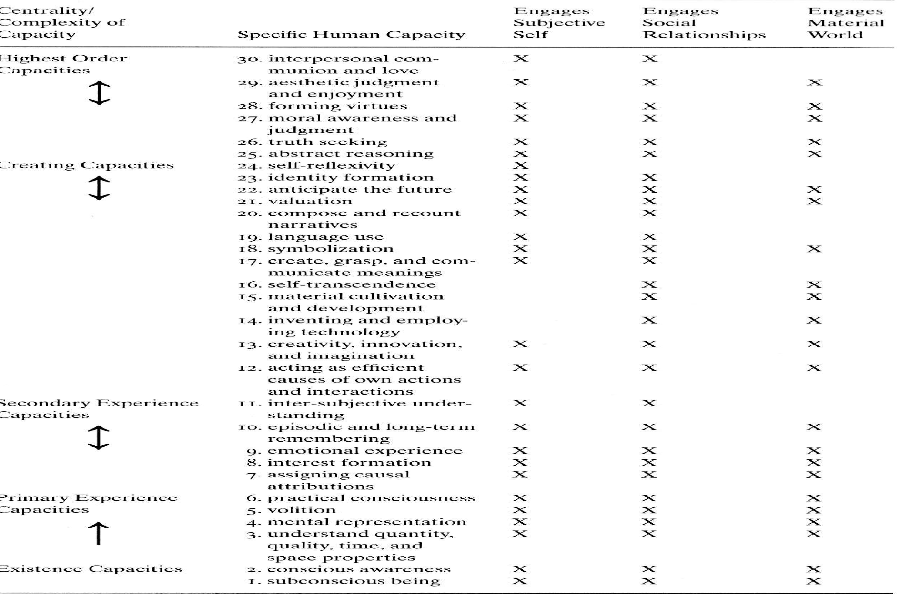

Slide 33
5.2 What is a person?
Centre of subjective experience, durable identity, moral commitment, social communication
Efficient causes of their own responsible actions and interactions
Sustaining the self in relationships with others and the material world
‘brokenness’
Notes:
First bullet. Subjective = ‘inside’. Durable identity = ‘know who we are’. Moral commitment = ‘acceptance of norms beyond the self’. Social communication = ‘inescapably social’.

Slide 34
5.3 Human beings are reasoning moral animals
Smith contends:
‘Moral’ = consistent with teleological purposes for living: motivation for human action is to act out and sustain moral order
Preferences and values derived from larger systems of moral order: higher order value systems to evaluate preferences.
Actions motivated by duty to do what is right/ good/ just, not just means/ ends to personal benefit.
Notes:
First bullet. Makes our lives significant.

Slide 35
5.4 Institutions are ‘morally oriented’
What are universities for?
‘pursuit of truth, instilling of virtues’
‘consolidating knowledge, producing new knowledge, communicating knowledge’
‘producing highly skilled workers, developing new technology, to make the economy more productive’
What are ‘markets’ for?
Notes:
What are markets for?
Presumption that people are broadly rational, naturally acquisitive, self-interested
Role of markets is facilitate production of goods and services, to meet human needs
Sustained by a framework of law to ensure ‘fair trading’.

Slide 36
5.5 Humans are believing animals
We are all ‘believers’: our lives/ knowledge
based on basic assumptions/beliefs (worldview)
Not open to empirical verification
No deeper, more objective, basis for differentiating between beliefs
Beliefs are not universal
To understand social life need to understand the context and function of beliefs that society holds - narratives
Notes:
Examples of belief systems:
{causation, uniformity of nature, temporal continuity of experience}
{existence of a loving God}
Second bullet. Data are theory laden.
Third bullet. Hence cultural diversity.

Slide 37
5.6 The role of narratives
We make stories and are made by them. Examples from C Smith Moral, Believing Animals, chapter 4:
‘Big narratives’ – but multiple versions e.g. Christian theologies
People may be unaware – ‘believing actors’
Western narrative traditions – parallels the Christian narrative – optimistic and pessimistic versions.
Notes:
Page 67 American experiment
Page 68 Militant Islam
Narratives for social sciences:
82 Liberal progress
83 Ubiquitous egoism

Slide 38
5.7 Evaluation of Smith’s social theory
Humans transcending biology – at other pole from evolutionary psychology
Very open ended – unclear how social science could ‘progress’.
Suggests a research programme – impact of worldview on key social institutions e.g. family

Slide 39
5.8 Evaluation from standpoint of Christian anthropology
Human beings as rational, moral agents
Consistent with a Christian understanding of human personhood – ‘moral, believing…’ - if only in idols.
Focus on narratives giving purpose
‘Brokenness’ - origins unclear (an add-on to emergent human personhood).

Slide 40
6. What next?
How, as Christians, should we work within social science paradigms that are defective in their understanding of human nature?
Could there be a specifically Christian social science?
If so, what would it look like?

